Slide 1

AUTONOMOUS TOILET CLEANING ROBOT
TEAM NUMBER : 9
TEAM MEMBERS :
BARATH KUMAR K (611220106008)
KIRUTHIKAA B D (611220106309)
KOWSHIKA M (611220106037)
IV YEAR ECE
TEAM GUIDE :
Mr. TAMILSELVAN A
Assistant Professor/ ECE

Slide 2
ABSTRACT :
Our IoT-based restroom cleaning robot merges IoT and a gas sensor for automated cleaning and air quality maintenance.
It autonomously navigates, removing debris and neutralizing odors, with real-time monitoring for remote supervision, maintenance alerts, and hygiene tracking. In the era of smart homes, demand for autonomous cleaners rises.
Our robot detects obstacles, cleans, and identifies pollutants for targeted cleaning. This innovation offers a smarter, healthier home cleaning solution, enhancing efficiency and user satisfaction.

Slide 3
OBJECTIVE :
The primary objective of cleaning robots is to automate floor care and household sanitation tasks, alleviating the burden of manual cleaning and freeing up time for other activities.

Slide 4
INTRODUCTION :
In a world of effortlessly hygienic public restrooms, an autonomous toilet cleaning robot, with gas sensor tech and IoT, achieves this vision.
Its gas sensor detects ammonia levels, communicating real-time cleaning needs to a central hub for freshness assurance.
Benefits include reduced workload, consistent hygiene, and minimized germ transmission.
IoT enables remote monitoring and maintenance for long-term optimization.

Slide 5
LITERATURE SURVEY : SURVEY 1 :
Title: Visual dirt detection for autonomous cleaning robots.
Authors: Richard Bormann, Xinjie Wang, Jiawen Xu, Joel Schmidt.
Techniques: Inverse Distance Weight Method, wireless sensor networks.
Merits: enhanced monitoring for ammonia gas hazards in livestock environments.
Demerits: Specific details on the scalability and reliability of the wireless network are not provided.

Slide 6
SURVEY 2 :
Title: Operation Mode Decision of Indoor Cleaning Robot Based on Causal Reasoning and Attribute Learning Authors: Yapeng Li, Dongbo Zhang, Feng Yin, and Ying Zhang Techniques used: Causal reasoning and attribute learning Merits: Enhanced decision-making for cleaning robot operation modes Demerits: Potential complexity in implementation and computational.

Slide 7
SURVEY 3 :
Title: Automation of Train Cab Front Cleaning with a Robot Manipulator Authors: Joao Moura, William Mccoll, Gerard Taykaldiranian, Tetsuo Tomiyama, and Mustafa Suphi Erden Techniques used: Robot manipulation for train cab front cleaning automation Impact: Enhanced cleaning efficiency and precision in train cab maintenance

Slide 8
EXISTING SYSTEMS :
Most cleaning robots are robotic vacuums. These are self-contained units that navigate your floors using sensors and maps, picking up dirt, dust, and pet hair.
Some robot vacuums can also mop. These models will typically have a water reservoir and a washable mopping pad.
Navigation can be basic or complex. Simpler models may bump around until they clean everything, while high-end models use lasers or cameras to create a map of your home and clean in neat rows.

Slide 9
BLOCK DIAGRAM
Arduino UNO Microcontroller
WiFi Module
PC or Mobile
GAS SENSOR
Cleaning Motor
Motor 1
Motor 2

Slide 10
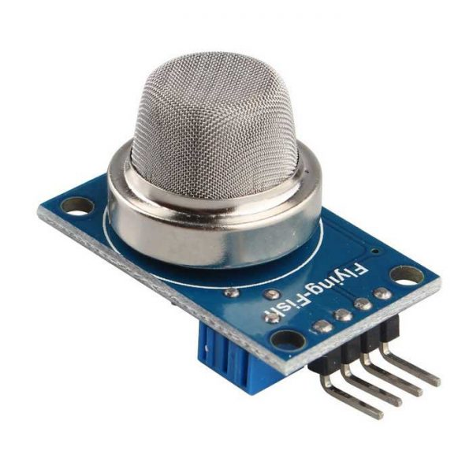
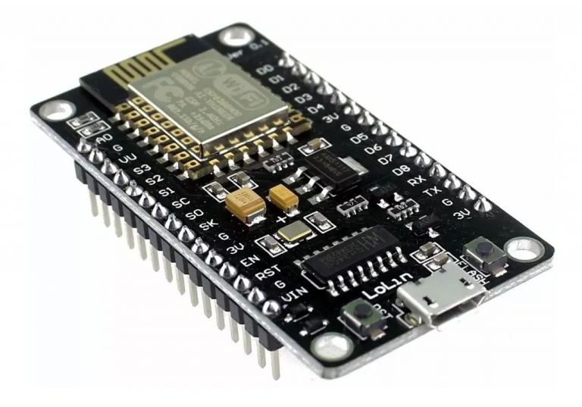
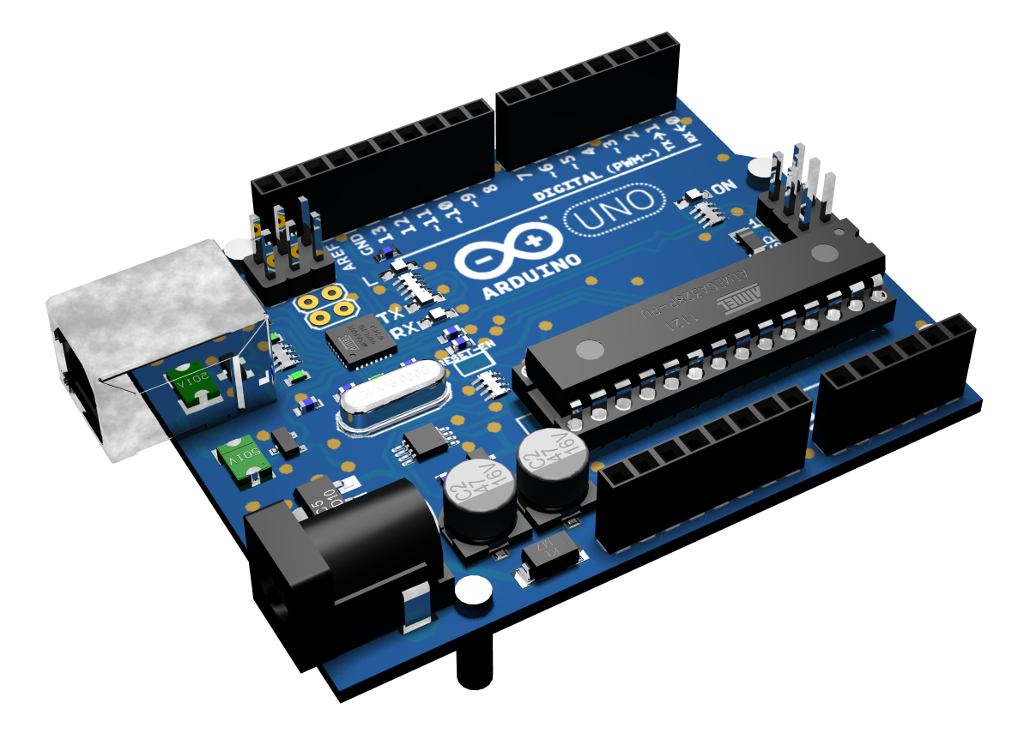
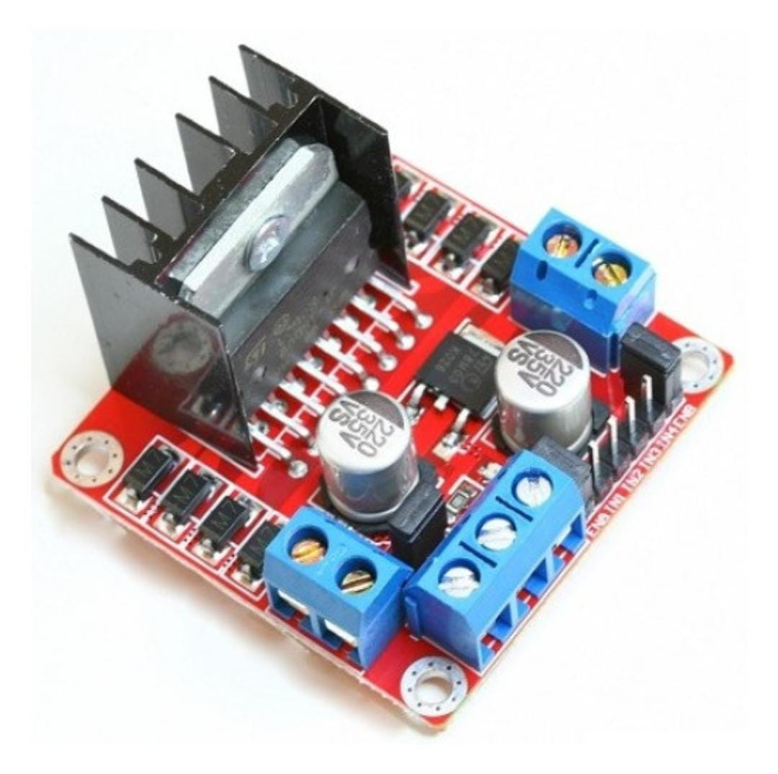
HARDWARE REQUIREMENTS
Arduino UNO Microcontroller
Gas Sensor
Robo car chassis
ESP 8266 Module
L298 Motor Driver Board Module

Slide 11
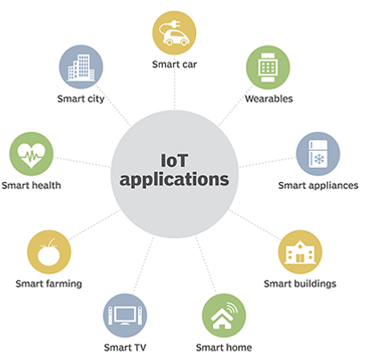
INTERNET OF THINGS

Slide 12
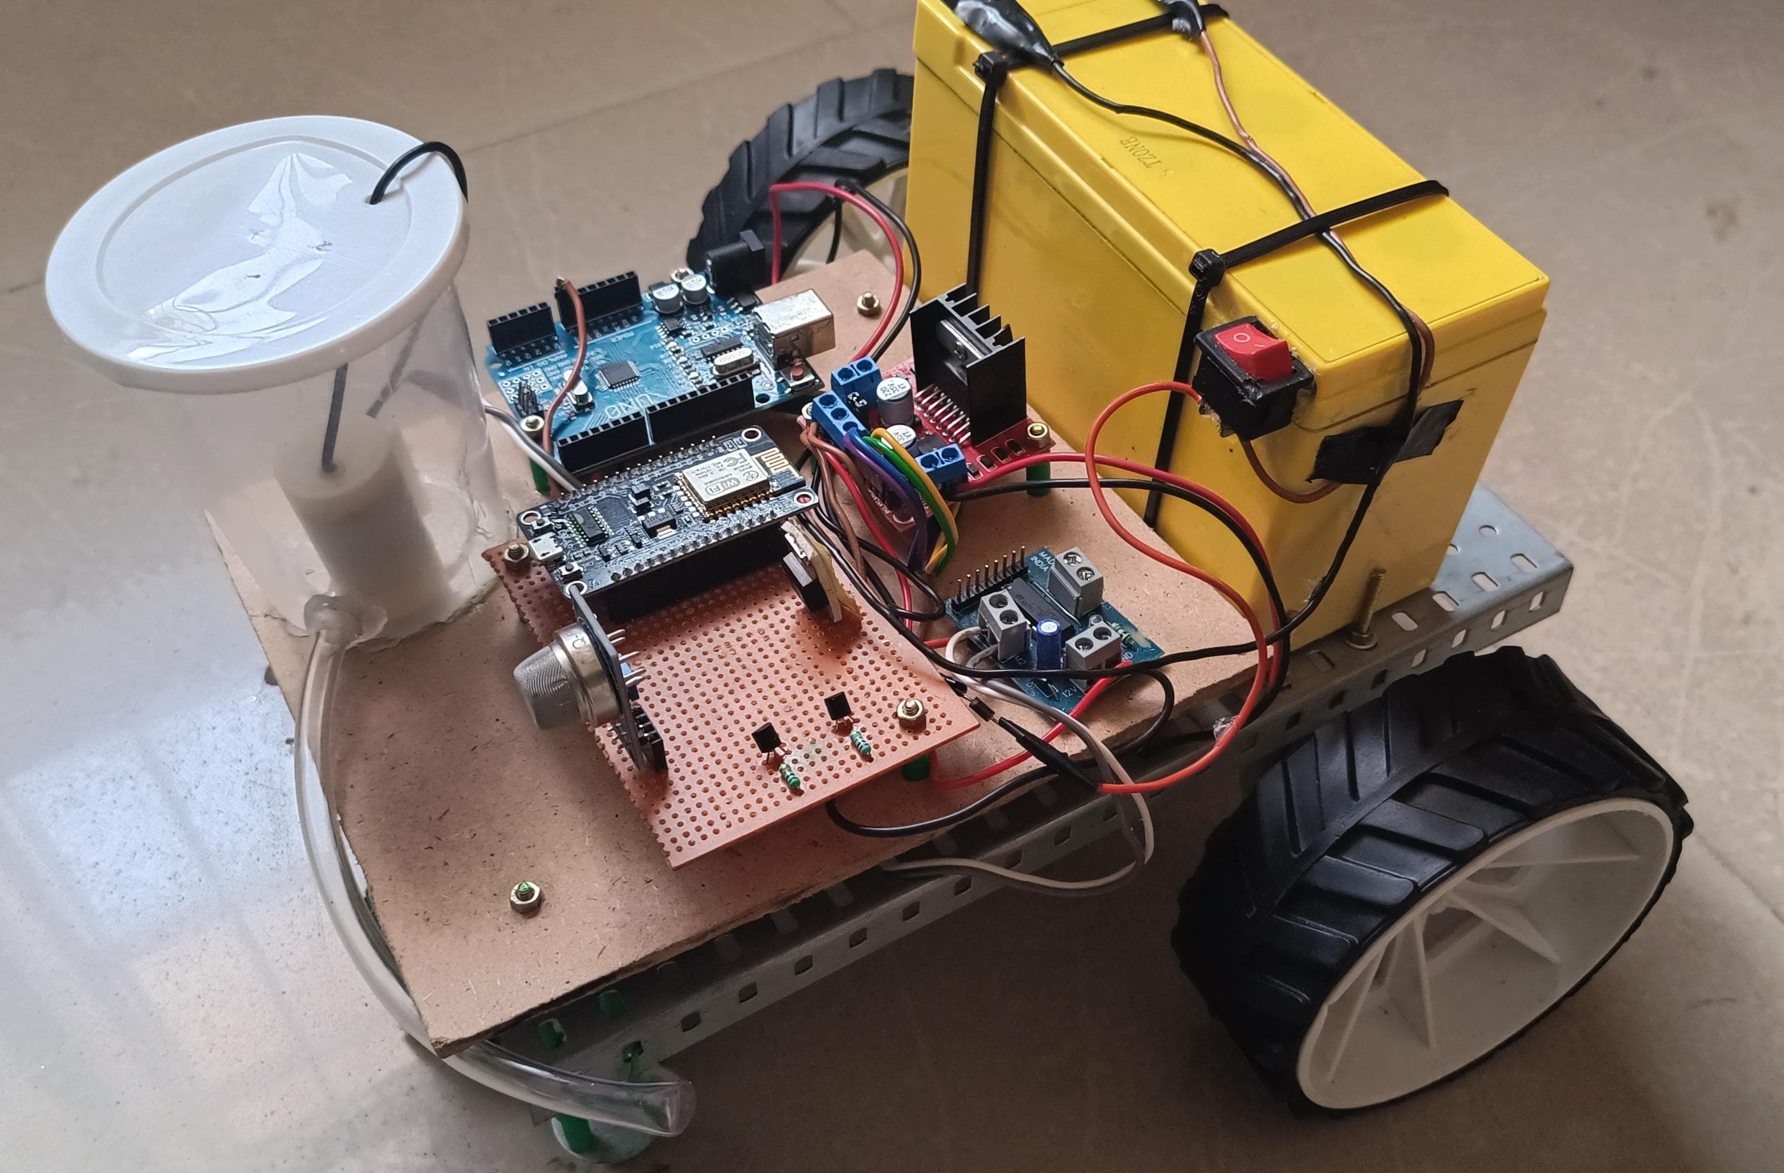
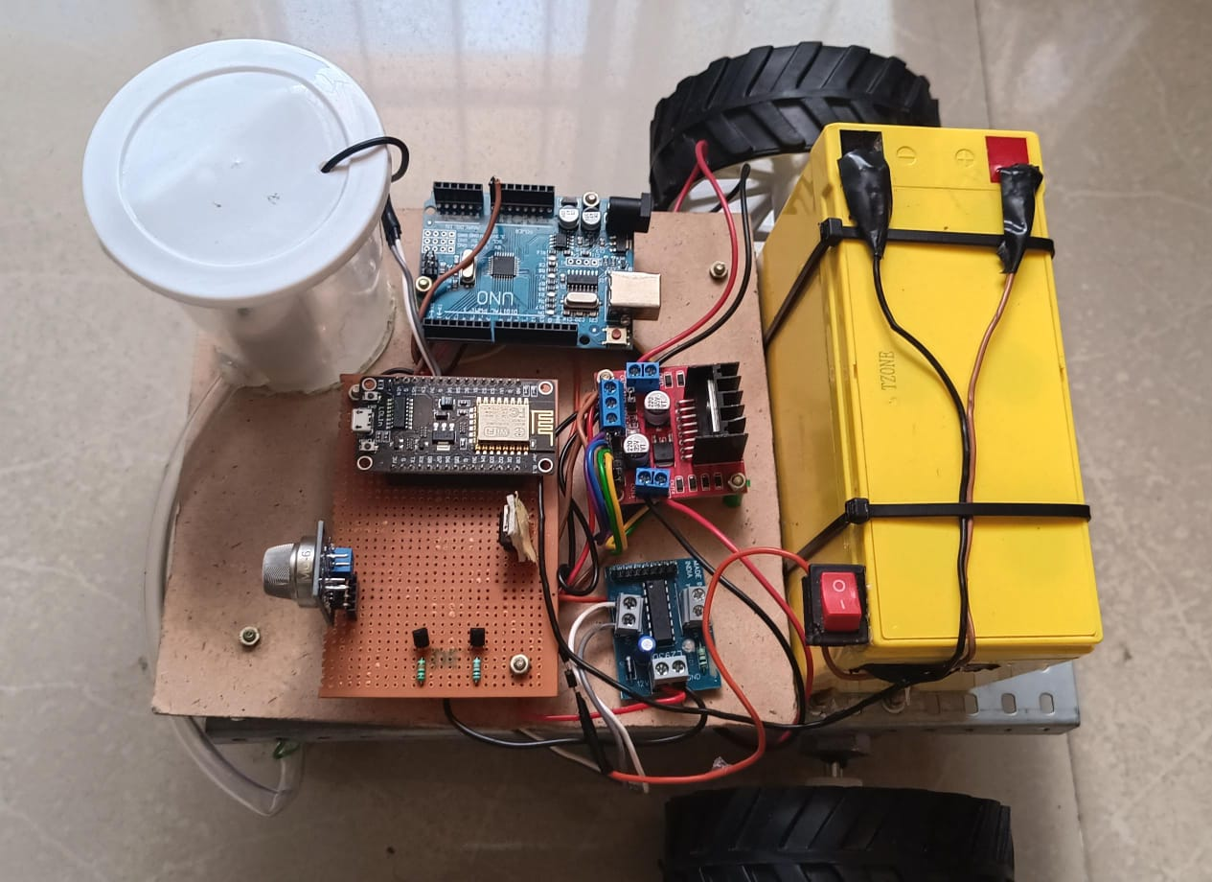
RESULT

Slide 13
CONCLUSION
An autonomous toilet cleaning robot with gas sensor technology and IoT is a significant leap in restroom hygiene.
IoT integration enables remote monitoring and control, allowing users to track schedules and initiate cleaning cycles remotely.
This automation ensures a consistently clean environment, reducing workload on staff and improving public health.
Overall, this innovative system offers targeted cleaning, remote management, and enhanced user experience in restrooms.

Slide 14
FUTURE SCOPE
The future of cleaning robots promises advanced restroom hygiene with integration of UV disinfection, automatic solution refilling, and AI-driven adaptability.
These innovations will revolutionize public restrooms, ensuring cleanliness and health. Expect adaptable robots controllable via voice commands or apps, expanding beyond homes to commercial and industrial settings, freeing human workers for other tasks.

Slide 15
REFERENCES
[1] R. Bormann, X. Wang, J. Xu and J. Schmidt, "DirtNet: Visual Dirt Detection for Autonomous Cleaning Robots," 2020 IEEE International Conference on Robotics and Automation (ICRA), Paris, France, 2020, pp. 1977-1983, doi: 10.1109/ICRA40945.2020.9196559.
[2] R. Parween, M. Vega Heredia, M. M. Rayguru, R. Enjikalayil Abdulkader and M. R. Elara, "Autonomous Self-Reconfigurable Floor Cleaning Robot," in IEEE Access, vol. 8, pp. 114433-114442, 2020, doi: 10.1109/ACCESS.2020.2999202.
[3] Y. Li, D. Zhang, F. Yin and Y. Zhang, "Operation Mode Decision of Indoor Cleaning Robot Based on Causal Reasoning and Attribute Learning," in IEEE Access, vol. 8, pp. 173376-173386, 2020, doi:10.1109/ACCESS.2020.3003343.
[4] J. Moura, W. Mccoll, G. Taykaldiranian, T. Tomiyama and M. S. Erden, "Automation of Train Cab Front Cleaning With a Robot Manipulator," in IEEE Robotics and Automation Letters, vol. 3, no. 4, pp. 3058-3065, Oct. 2018, doi: 10.1109/LRA.2018.2849591.

Slide 16


